Slide 1
Super Store Sales Dashboard
Data Analytics Internship task-3
By: Somasekhar Kadiyam
Tool: Microsoft Power BI
Dataset: Superstore Sales (Kaggle)

Slide 2
Objective:
To design an interactive Sales Dashboard that provides insights into key performance metrics like Sales, Profit, and Orders across various business dimensions.
Dataset Used:
Superstore Sales Dataset(kaggle)
Rows: ~150 | Columns: 13
Key Fields: Order Date, Sales, Profit, Region, Category, Segment, Payment mode, Ship mode.
Tools Used: Power BI Desktop

Slide 3
Business Goals:
Analyze sales and profit trends over time.
Identify top performing regions, categories, and products.
Understanding customer purchase behavior.
Enable business stakeholders to make data driven decisions.
KPI’s (Key Performance indicators):
Total Sales
Total Profit
Total Orders
Profit Margin(%)
Sales Growth YoY

Slide 4
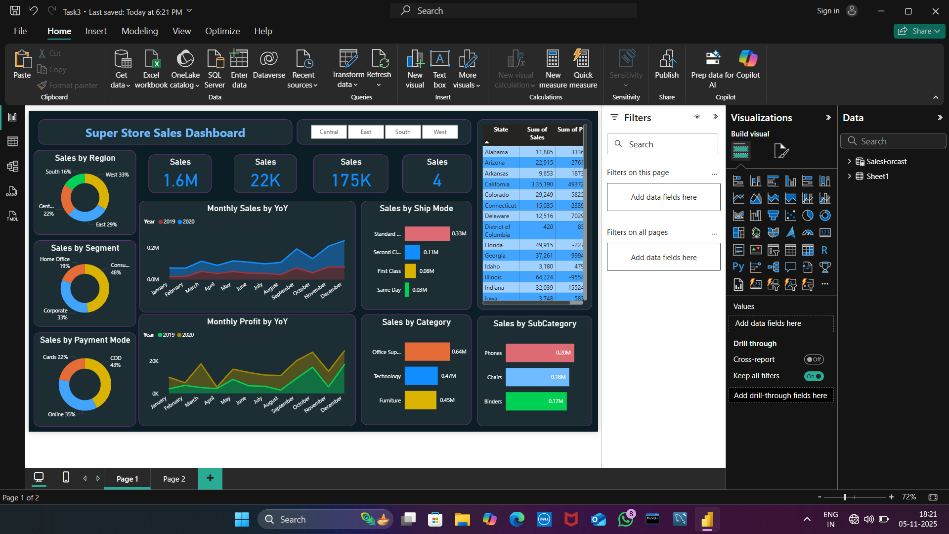
Dashboard Overview:

Slide 5
Key Components:
Cards: Total sales(1.6M), Profit(175k), Orders(22k)
Donut Charts: Sales by Region, Segment, Payment mode
Line Charts: Monthly Sales by Category & Sub-category
Bar Charts: Sales by Category & Sub-category
Table: Detailed breakdown by city/product
Interactive Features:
Slicers for Region, Year, and Category
Hover tooltips for insights
Filter-based interactivity

Slide 6
Key Insights:
West and East regions contribute the highest sales share.
Technology category yields the highest profit margin.
Sales show a positive trend in Q4 of each year.
COD is the most preferred payment method.
Office Supplies has consistent sales but lower profit compared to Technology.

Slide 7
Conclusion:
The Power BI dashboard provides a comprehensive view of sales and profit performance, helping stakeholders track KPIs efficiency and identify growth opportunities.
Recommendations:
Increase focus on low-profit categories.
Invest in marketing for underperforming regions.
Analyze customer segment trends quarterly.
Extend dashboard for future sales forecasting.

